Slide 1
MITE Teaching Awards
2022

Slide 2
The President’s Award for Academic Excellence
This award is given to an individual or a group of individuals who has made a lasting impact on our academic mission, in addition to patient care, and has demonstrated a commitment to the larger community. The impact on the academic mission should be something that will have a sustained and lasting contribution to our organization. This contribution may be demonstrated in any form of impact
through any method.

Slide 3
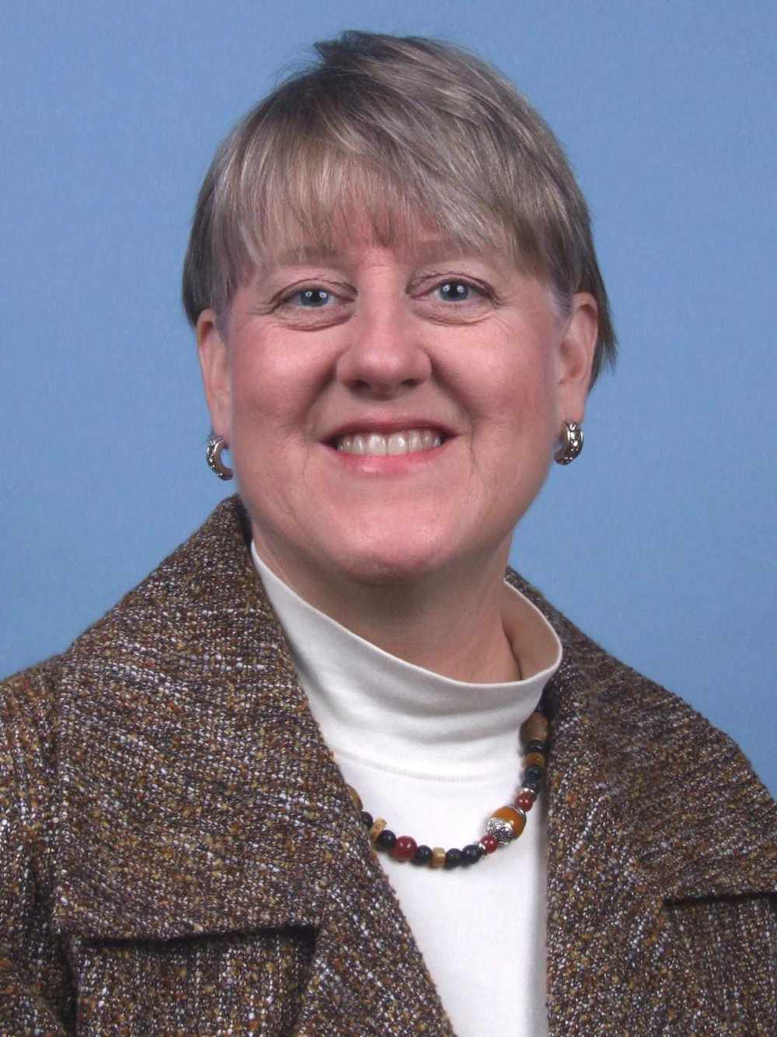
Jo Linder, MD
“Dr. Linder’s numerous contributions to Medical Education will have longstanding effects on the academic mission at MMC/MH, and in the entire State of Maine. She was one of the planning members of the TUSM Maine Track and has been its only Dean for Students since its inception. She is lauded by the 100s of alumni as a strong student advocate and devoted mentor. Jo has worked, specifically, to increase underrepresented-in-medicine student matriculation. At the 2021 graduation, Jo was given accolades for her dedication to ensuring all students feel comfortable and can learn safely, no matter their cultural, ethnic, religious, gender, or sexual orientation backgrounds. The Maine Track’s success at populating physicians in Maine, including in underserved areas, is largely due to Jo’s advocacy for students from admissions, to graduation, to ongoing outreach to alumni. In advance of Jo’s retirement this summer, we feel that her commitment to the Maine Track, and her ethos to be the students’ Dean in every aspect of their lives, should be commended and celebrated. Her lasting impact on future generations of students and to the MMC Department of Medical Education is priceless. “
President’s Award for Academic Excellence 2022 Recipient

Slide 4
MITE Award for Inter-professional Teaching Excellence
This truly unique award recognizes any individual from any profession that has had a lasting impact on our learners and our patients.
The awardee is an individual who has made an impact on our learners whether student, resident or peer to peer, an impact on patient care, and commitment to the larger community.

Slide 5
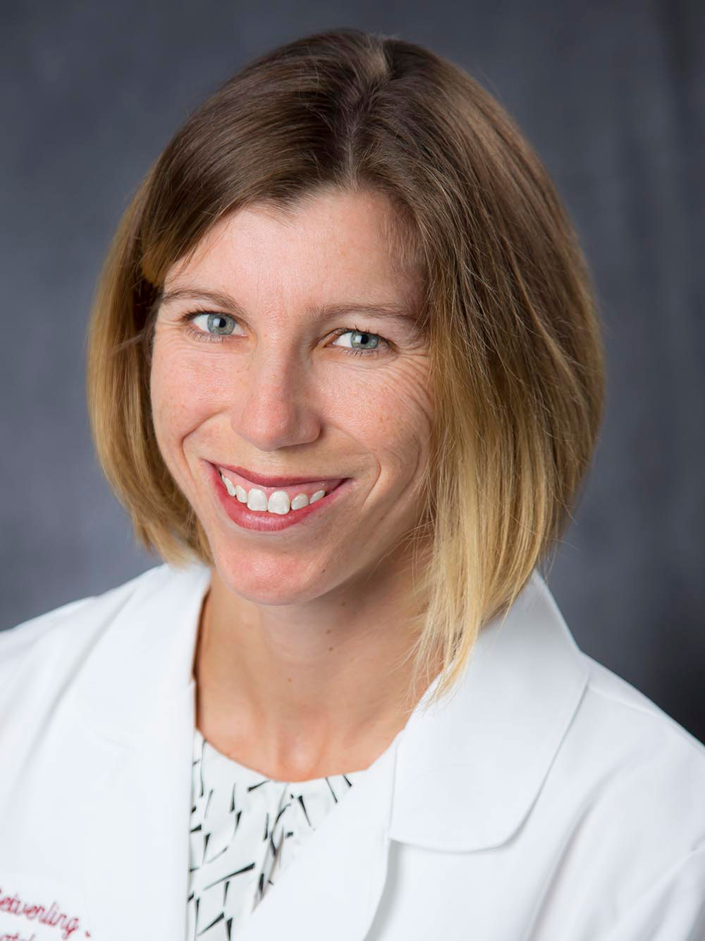
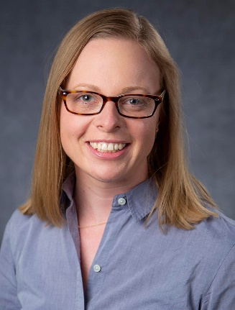
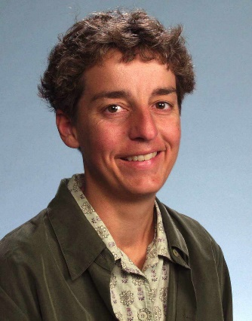
MMP Dermoscopy Team
Elizabeth V Seiverling, MD
Kathryn M Stevens, APRN-FNP
Peggy R Cyr, MD
“Dermatologic care is a very limited resource in our state, and these three have dedicated themselves to expanding our reach by teaching primary care physicians, advanced practice providers, and primary care residents. Over the last three years, they developed and expanded our ECHO program (Extension for Community Healthcare Outcomes). Their teaching excellence helps us expand our reach and ensure Mainers have access to specialized care when needed. In addition to preparing engaging lectures, they have studied the impact of this teaching by evaluating the stage of melanoma at diagnosis across our state in hopes of improving population-level outcomes. The multimodal educational curriculum and telementoring has helped learners at all different levels gain confidence in providing exception dermatologic care.”
MITE Award for Inter-professional Teaching Excellence 2022 Recipients

Slide 6
MITE Award for Innovation
in Teaching
This award is given to an individual or a group of individuals who have implemented outstanding innovative teaching approaches to improve learning outcomes. Innovative teaching is broadly defined. Some examples include the use of new instructional technologies, the use of traditional technologies in creative ways, novel approaches to instruction, and new ways to engage students in the learning process.

Slide 7
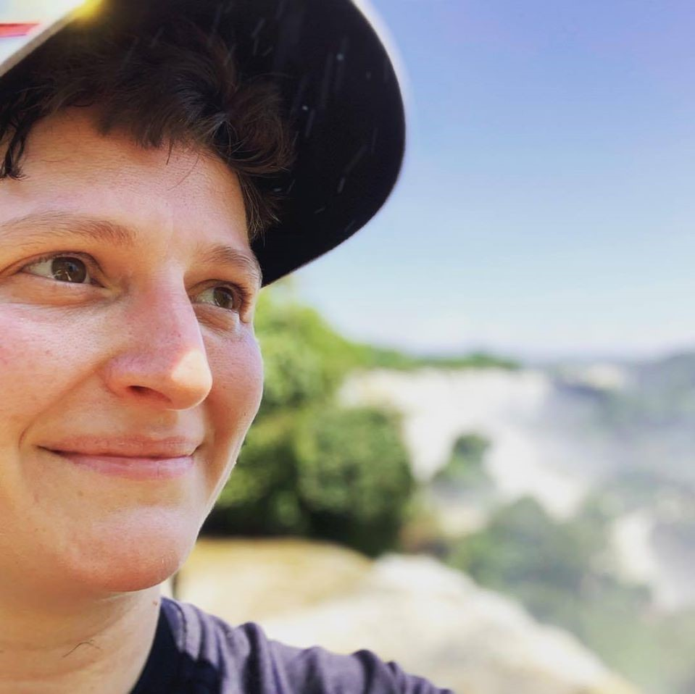
MITE Award for Innovation in Teaching 2022 Recipient
Brandy Brown, LCSW
“Brandy Brown has started a new medical elective in The Gender Clinic, which is an opportunity that not a lot of schools may offer at this point. Increased focus on interprofessional learning is also innovative as in integrated learning model. She has reached out interprofessionally to bring medical students on to the Equitable Patient Care Committee to increase student voice and participation in patient advocacy. Brandy also teaches Family Medicine medical residents. Additionally, she is partnering with Family Medicine on developing a transgender simulation case for potential use by medical students and residents in different specialties. She also involved a medical student, Sarah Hemphill, in editing the case. Overall, while Brandy could also be considered for the interprofessional award, her dedication to and success in reaching across professional lines to advance care of and education about marginalized patient populations is truly innovative.”

Slide 8
MITE Award for Educational Leadership and Mentorship
This award is given to individuals who have a broad array of educational leadership and mentorship skills that has had a lasting impact on our learners, whether students, residents, fellows or faculty. This awardee is a role model, pioneer, provides guidance on professional and career development and has made a difference in lives of patients and the larger community.

Slide 9
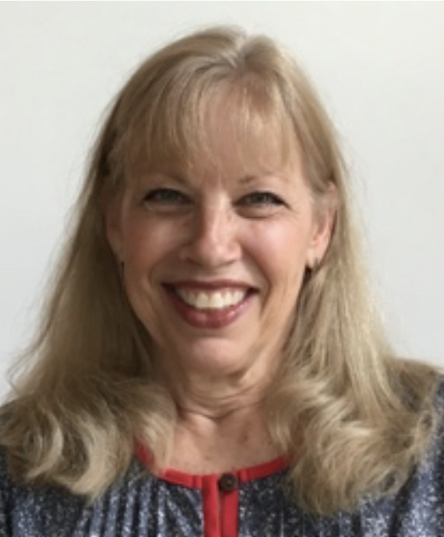
Vicki Hayes, MD
“Vicki has been a long-time resident preceptor, as well as Director of the Competency-Based Apprenticeship in Primary Care. As CAP Director, Vicki recruits 40 faculty to host students in their clinic for 15 days during second year. She provides the attendings with faculty development to enhance their teaching skills and plans and implements Skills Workshops to ensure students are ready to see patients. Vicki is universally highly-rated as a teacher and course director. She is described as responsive to feedback, easily accessible and an excellent teacher. In addition, she is a MITE Academy Master Educator through which she mentors physicians building their academic portfolios. Another of her mentorship roles is as a M24 TUSM coach. She provides professional and personal development for a cohort of 10 students and teaches them during their Practice-Based Learning Course. Furthermore, she serves as faculty sponsor for the Family Medicine Interest Group and a student-run “mini-medial school” program for local high schools. The breadth of Vicki’s mentorship and educational influence is truly unparalleled.”
MITE Award for Educational Leadership and Mentorship 2022 Recipient

Slide 10
Simulation Teaching Award
This award is given to an individual who has made an impact on learners, whether it be UME (students), GME (residents and fellows) or CME (healthcare teams) using the simulation methodology. This individual excels at the core principles of simulation education (pre-briefing and debriefing, relevant and appropriate learning objectives, evaluation) and is a mentor for other simulation educators. Most importantly they consistently provide a learning environment where reflection on action occurs in a psychologically safe manner.

Slide 11
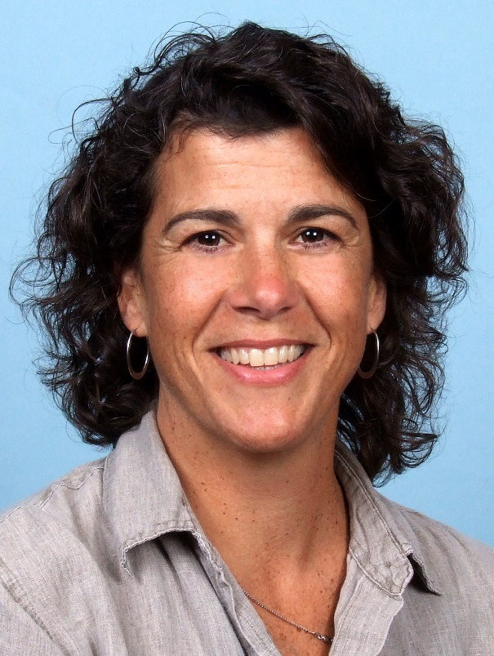
Shelly Chipman, RN
“Shelly is foundational in the running of the Sim Center. Her expansive knowledge-base and tireless commitment to making things not only run, but run well, keeps us rolling forward. She is thorough, passionate, and a behind the scenes actor in many ways – her work as faculty could be overlooked among the many hats she wears – but it is one that she wears exceedingly well.”
“She is the single greatest, most passionate teacher I have come across in simulation. I am fortunate to see her working on every level of simulation from creation to executing to delivering exquisite debriefs and even probing for nuggets of info that learners acquired while doing the simulation.”
MITE Award for Simulation Teaching Award
2022 Recipient

