Slide 1
MITE Teaching Awards
2023

Slide 2
The President’s Award for Academic Excellence
This award is given to an individual or a group of individuals who has made a lasting impact on our academic mission, in addition to patient care, and a demonstrated a commitment to the larger community.
The impact on the academic mission should be something that will have a sustained and lasting contribution to our organization.

Slide 3
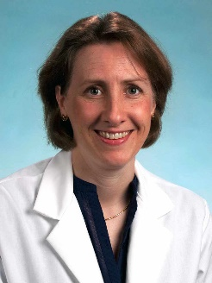
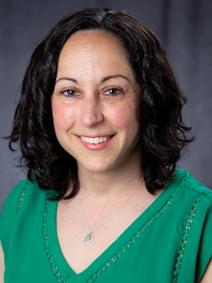
President’s Award for Academic Excellence 2023 Recipients
The Barbara Bush Children’s Hospital Scholarship Academy Leadership Team
Mary Ottolini, MD, MPH, MEd
Alexa Craig, MD, MSc, MS
Laura Faherty, MD, MPH, MSHP
"The BBCH Scholarship Academy (SA) leadership team has transformed the culture of academic pediatric scholarship and rapidly accelerated scholarly pediatric productivity across MaineHealth. Mary’s leadership and vision, the team’s ingenuity to build the academy’s infrastructure by funding its support roles, and Alexa and Laura’s mentorship and organization have been instrumental to support this growth and success.
The BBCH SA leaders provide project and career mentorship for 30+ multidisciplinary members, resulting in faculty development and measurable progress on their projects. Among supported projects, 44 have IRB approval of which 13 were presented at regional/national meetings and 6 have been published. Project success has led to improved care delivery, process optimization, and innovative teaching methods impacting patient care, referral hospitals, and the community.
BBCH SA members report that the Academy has “provided fabulous resources,” “created a safe community” of learning, and “facilitated collaborations across Pediatric departments.” Other members report that the BBCH SA, “provided me inspiration and empowerment to explore relevant topics that support future patient care initiatives,” has been “a respite that keeps me fresh for my clinical time,” and has “reversed my burn-out.” These testimonies speak directly to the academic excellence Mary, Alexa, and Laura cultivate in the BBCH SA."

Slide 4
MITE Award for Interprofessional Teaching Excellence
This award is given to an individual or a group of individuals who has made an impact on our learners whether student, resident or peers, in addition to patient care, and have demonstrated a commitment to the larger community. They should demonstrate some form of teaching excellence through any method.

Slide 5
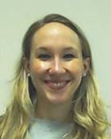
MITE Award for Inter-professional Teaching Excellence 2023 Recipient
Ashley Gale, PharmD
“Dr. Gale is an integral member of the Family Medicine (FM) inpatient service team. As a pharmacist, she brings a crucial fund of knowledge that enhances both patient care and the learning experience on our team for residents and medical students. Specifically, Dr. Gale joins the FM team for Interprofessional Partnership to Advance Care and Education (IPACE™) rounds at the patient’s bedside, as well as table rounds. In either setting, she has a way of deftly asking a question or raising in a concern in a way that allows for group discussion and subsequent improvement in care.
Dr. Gale approaches teaching by setting a friendly and open learning environment, whether teaching “on-the-fly” or in a more formal presentation setting. She is always willing to discuss a relevant topic during rounds and often has a clinical pearl to add. Dr. Gale also serves as a mentor to pharmacy residents, demonstrating an ability to teach across disciplines. Dr. Gale has been recognized with several teaching awards from the FM residents, a testament to her contribution to our team.”

Slide 6
MITE Award for Educational Leadership and Mentorship
This award is given to an individual who demonstrates evidence of a broad array of educational leadership and mentorship skills that has had a lasting impact on our learners, whether students, residents, fellows or faculty.

Slide 7
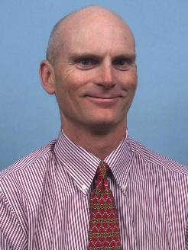
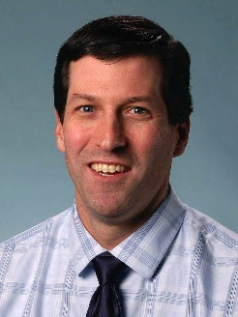
MITE Award for Educational Leadership and Mentorship 2023 Recipients
James Whiting, MD
Thomas Gearan, MD
Brian Youth, MD
"Dr Whiting has been a tireless advocate for the surgical residency for many years. His personal experience with administering the national oral boards combined with his interest in both didactic and operative learning have made him the backbone of surgical education at our program.
On paper, he meets quarterly with residents to discuss career decisions and reaching residency milestones and case requirements, but that is the job - more importantly, he offers tailored advice regarding fellowship, fosters mentorship and research relationships, and encourages residents to attend conferences where he facilitates networking with the ultimate goal to further our careers.”
“I nominate Dr. Tom Gearan for his extraordinary vision, leadership and mentorship over the past 14 years as Program Director for the Internal Medicine Residency Program. Tom has been an innovator, involved from the outset with the ACGME granted iPace Program, the champion for rural GME with the unique and now copied RIMM program and under whose guidance, the IM Residency program has transitioned to a 4+2 clinical schedule, separate intern and senior resident academic half day conference series.
Tom is humble, focused on creating optimal clinical experience for trainees and an outstanding clinician to boot. He will be leaving his role as PD in the next year and continuing his role as assistant DIO as well as taking on statewide responsibility for coordinating GME training. His mentorship for many and most particularly the nearly 30 IM Chief Residents under his direct supervision, has been central in the personal and professional growth of these remarkable young physicians.”
“Brian is an 18 year veteran of directing the general pediatrics residency at Maine Medical Center and has lead our program through countless difficulties and successes over the last 2 decades. He has mentored hundreds of medical students, residents, and early career faculty members during that time on topics ranging from quality improvement to wellness to scholarship. Brian has a passion for community and rural pediatrics and our program has supplied rural pediatricians all over Maine and many other states under his leadership.
He has additionally mentored many residents who have gone on to successful careers in pediatric subspecialties, many of whom have returned here to Maine to practice because of their experiences at BBCH/MMC under his leadership. Brian is retiring this year from his role as program director and I can’t think of a better way to honor his service to our hospital and medical education community than with this type of award.”

Slide 8
MITE Award for Innovation in Teaching
This award is given to an individual or a group of individuals who have implemented outstanding innovative teaching approaches to improve learning outcomes.
Innovative teaching is broadly defined. Some examples include the use of new instructional technologies, the use of traditional technologies in creative ways, novel approaches to instruction, and new ways to engage students in the learning process.

Slide 9
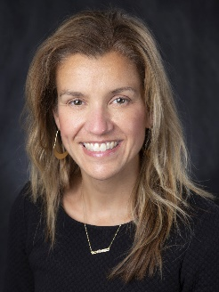
MITE Award for Innovation in Teaching 2023 Recipients
Angela Leclerc, PA-C
Patricia Lerwick, MD
"I’d like to nominate Angie Leclerc and Patti Lerwick for the “MITE Award for Innovation in Teaching”. This is for developing our first-ever APP residency program. This effort was truly a labor of love – they had insufficient resources at every junction and yet persevered to create an incredibly successful program. I’m confident that other programs will follow in their shoes, and I recently heard Kneka Smith discussing “lessons learned” from the program – GME had had no idea how to execute on it, either!
Why “innovation in teaching?” Well, this is a first-ever program, requiring the development of a curriculum and infrastructure to provide instruction. The APP residents train side by side with resident physicians, and receive a blended educational program, some of which is unique to the APPs, and some of which they share with physicians. Above all, Angie and Patti have served as mentors to the APP residents, teaching them at the bedside and in the classroom, and working through the anxiety and tribulations of medical training without a preexisting blueprint. Kudos to them both and thanks for the massive efforts undertaken."

Slide 10
Simulation Teaching Award
This award is given to an individual who has made an impact on learners, whether it be UME (students), GME (residents and fellows) or CME (healthcare teams) using the simulation methodology.
This individual consistently provide a learning environment where reflection on action occurs in a psychologically safe manner.

Slide 11
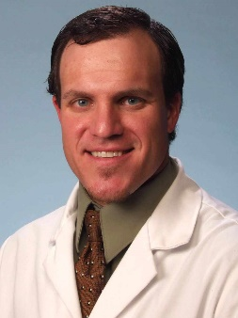
MITE Award for Simulation Teaching 2023 Recipient
Jeffrey Holmes, MD
“Beyond Dr. Holmes’ role as the Director of Simulation Education for the Department of Emergency Medicine, Dr. Holmes has been involved in numerous other simulation-related educational endeavors. Notable significant projects have included serving as core faculty for the TUSM Capstone Difficult Conversations simulation course since 2013, teaching simulation methodology to aspiring educators at the Hannaford Simulation Center Instructor Course and developing courses in both neonatal and obstetric care to improve care at rural hospitals across Maine. Additionally, Dr. Holmes has mentored simulation champions at MaineHealth hospitals, served on numerous local and national simulation committees, received grants and published a great deal in the field of simulation.
Dr. Holmes has been dedicated to simulation education at MaineHealth and Maine Medical Center for fifteen years and has made significant contributions to UME, GME and CME learners. He is a model of a simulation educator through demonstrating innovation, embarking upon process improvement and broadening the scope of simulation to educate large, interdisciplinary groups and rural providers. The field of simulation at MMC has been significantly positively impacted by the efforts of Dr. Jeffrey Holmes and we believe this award would be a wonderful means of acknowledging this as he transitions away from his role as the Director of Simulation for EM and focuses more of his time on his Regional Director of Simulation for the Hannaford Simulation Center role.”

